Slide 1
Smart Renting in Poland: A Budgeting Workshop for International Students
Welcome to your comprehensive guide for navigating Poland's rental market as an international student. With over 105,404 international students choosing Poland for their education, you're joining a growing community.
Living costs in Poland remain affordable, typically ranging from 1500-2500 PLN per month. This workshop will equip you with the knowledge to make smart financial decisions.

Slide 2
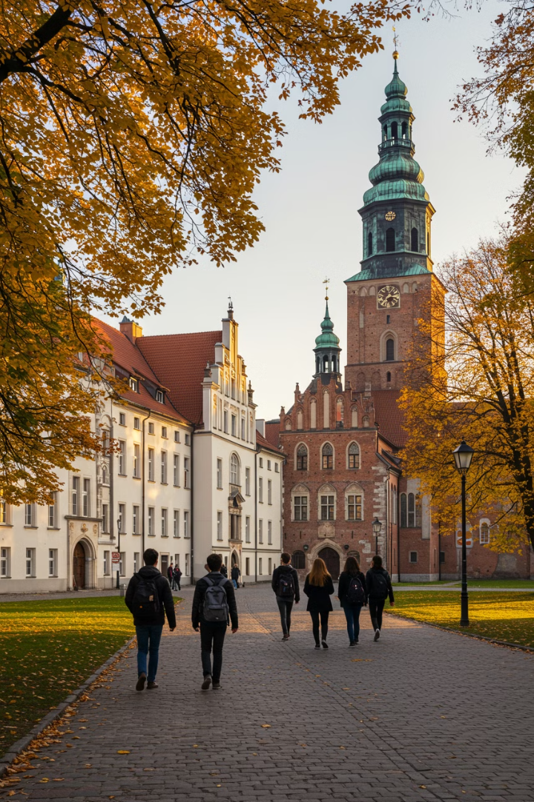
Why Poland? Student Destination Insights
179 Countries
Growing Numbers
Affordable
Students from around the world choose Poland for its diverse academic environment.
International student population increases yearly, creating multicultural campuses.
Lower tuition and living costs compared to Western European countries.
Quality Education
Numerous English-language programs with international recognition.

Slide 3
Understanding the Polish Rental Market
Winter
Spring
Higher demand and prices (1300-3200 PLN)
Semester transitions drive market activity (1500-3500 PLN)
Fall
Summer
Academic year begins, competitive market (1500-3500 PLN)
More affordable options available
(1100-3000 PLN)
The Polish rental market varies significantly by season and location. Warsaw, Krakow, Gdansk, and Wroclaw remain the most popular student cities.

Slide 4
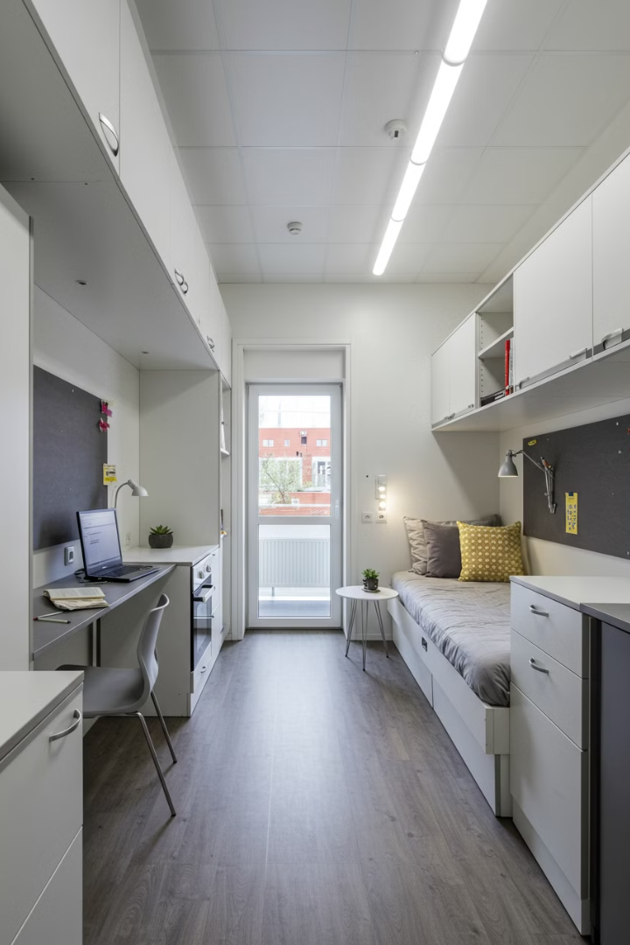
Accommodation Options Overview
University Dormitories
Shared Apartments
Most affordable option at 500-1300 PLN monthly. Limited availability but excellent for networking. Basic amenities with shared facilities.
Popular choice costing 900-1800 PLN monthly per room. Balance between privacy and affordability. Cultural exchange opportunities.
Private Rentals
Complete independence at 1800-4000 PLN monthly. Full amenities but higher overall costs. Best for those seeking privacy.
Location significantly impacts pricing across all accommodation types. City center options command higher rates.

Slide 5
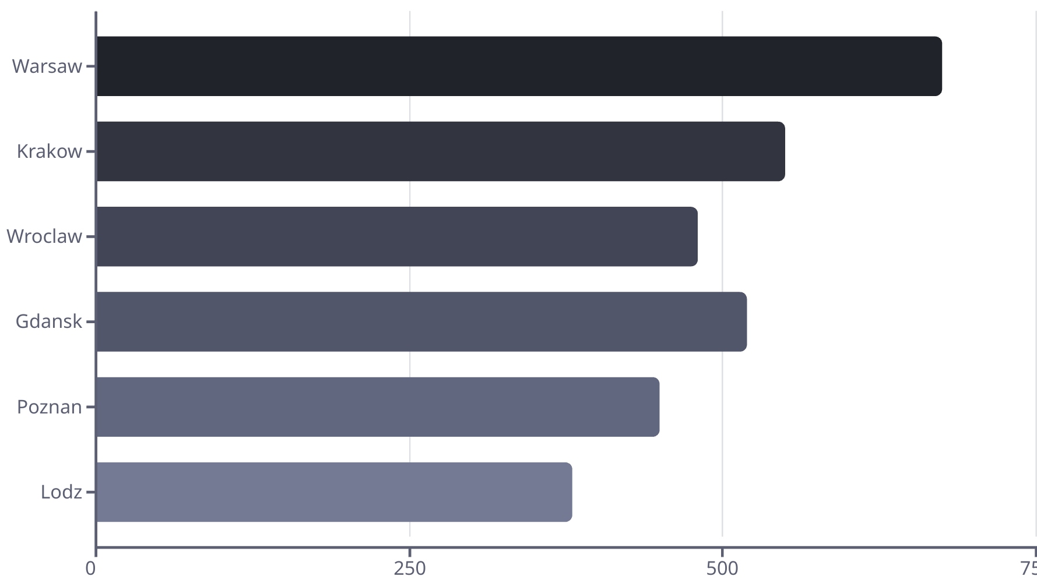
Rental Cost Breakdown by City
Warsaw remains the most expensive Polish city for students. Smaller cities offer more budget-friendly options. Most students spend 501-800 zloty monthly on accommodation.

Slide 6
Legal Considerations for Renting
Security Deposit
Two-month security deposit is standard practice. Keep documentation of property condition before moving in.
Tenant Rights
Polish law protects tenants. Landlords cannot evict without proper notice and legal grounds.
Rental Contract
Insist on a written agreement in both Polish and English. Define responsibilities for repairs and utilities.
Visa Requirements
Registered address may be required for visa extensions. Ensure your rental meets these requirements.

Slide 7
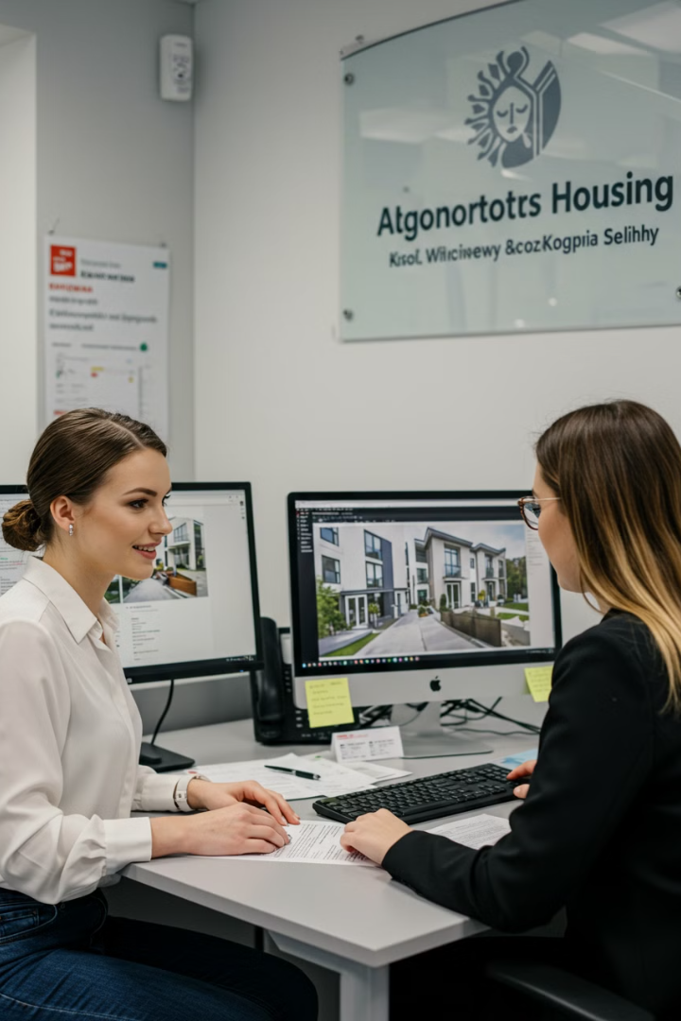
Finding the Right Accommodation
University Housing Office
First stop for dormitory applications and vetted off-campus options. Reliable but limited selection.
Online Platforms
Sites like Otodom, Gumtree, and OLX offer extensive listings. Watch for scams.
Social Media Groups
Facebook groups for international students often share housing opportunities. Networking advantage.
Local Agencies
Professional service but includes finder's fee. More options for premium accommodations.

Slide 8
Shared Accommodation Strategies
Financial Benefits
Social Advantages
Finding Roommates
Reduced rent by 40-60%
Built-in social network
University matching services
Lower utility costs per person
Cultural exchange opportunities
Student Facebook groups
Shared household items
Language practice
International student events
Split internet and TV packages
Shared meal possibilities
Shared living drastically reduces individual expenses while enhancing your international experience.

Slide 9
Utility Cost Management
Internet
Heating
40-100PLN monthly for high-speed connection. Student discounts sometimes available.
160-350 PLN monthly. Significant seasonal variation with winter peaks.
Electricity
100-200 PLN monthly. Higher in winter due to shorter daylight hours.
Water
80-150 PLN monthly. Often included in dormitory fees.
Average utility costs total approximately 700 PLN monthly. Many rental agreements include some utilities, so verify what's covered.

Slide 10
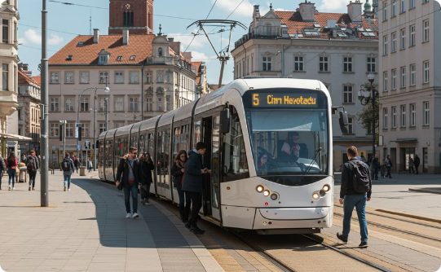
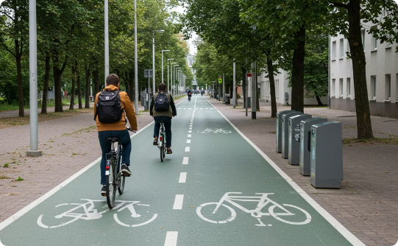
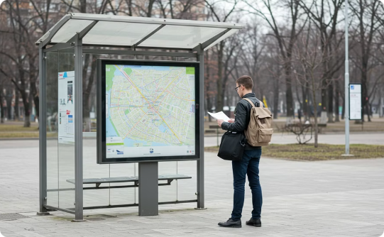
Transportation Considerations
Public Transit
Cycling
Transportation Apps
Comprehensive networks in major cities. Student passes cost 165 PLN for 3 months of unlimited travel. Significant savings over pay-per-ride options.
Poland's cities increasingly bike-friendly. Many universities offer bike rentals. Cost-effective and environmentally friendly option.
Jakdojade app provides comprehensive route planning. Most cities offer real-time tracking of public transit vehicles.

Slide 11
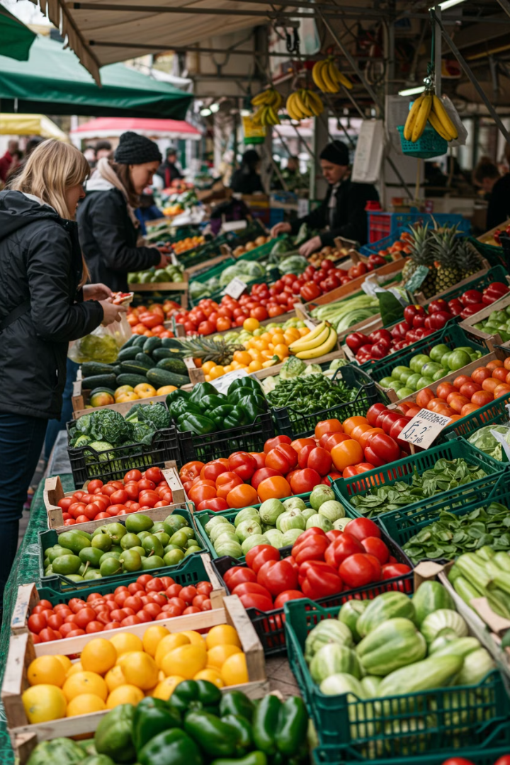
Food and Living Expenses
600 PLN
Monthly Groceries
Average student grocery budget at affordable supermarkets like Lidl, Biedronka, and Auchan
350 PLN
Dining Out
Monthly budget for occasional restaurant meals and coffee shops
10-30 PLN
Student Lunch
Average cost for a meal at university canteens or milk bars (bar mleczny)
30%
Savings
Potential savings by shopping at local markets and cooking at home

Slide 12
Financial Planning Tools
Budgeting Apps
Expense Tracking
Emergency Fund
Tools like Mint, YNAB, and local Polish options help track expenses in złoty and your home currency.
Regular monitoring prevents overspending. Set alerts for bill payments and financial goals.
Maintain savings equal to 3 months of expenses. Essential for international students far from home.
Currency Exchange
Use Revolut, TransferWise, or Polish Kantor exchanges to minimize conversion fees.

Slide 13
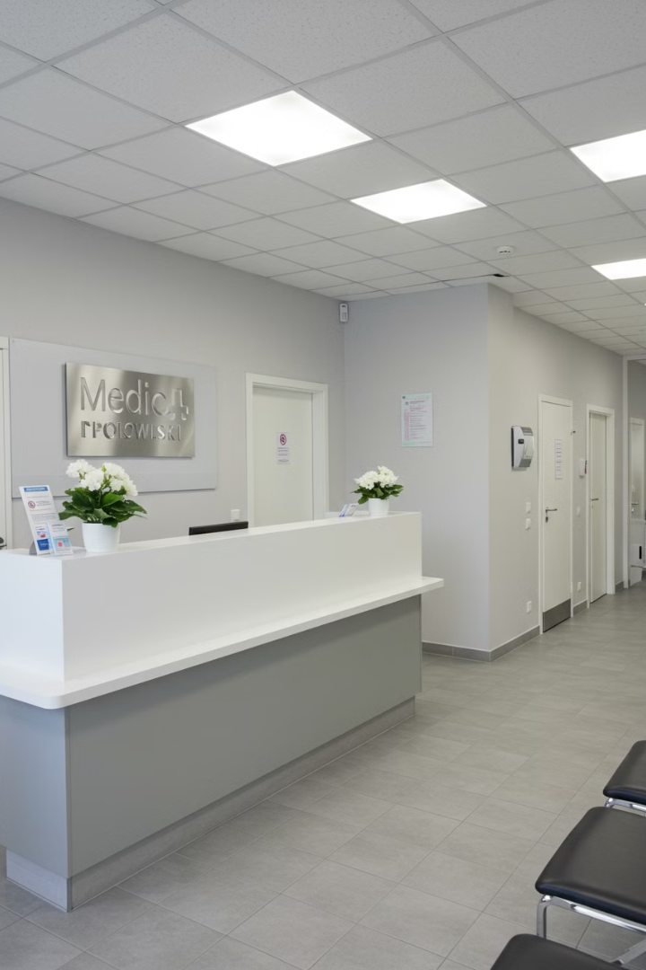
Health Insurance and Medical Costs
Insurance Requirements
Medical Services
International students must have health insurance. EU students can use European Health Insurance Card (EHIC). Non-EU students need private coverage costing 50-200 PLN monthly.
Public healthcare accessible with insurance. Many universities have on-campus health centers. English-speaking doctors available in major cities at university clinics.
Prescription Costs
Medications generally affordable compared to Western Europe and US. Student insurance often provides additional discount. Keep receipts for insurance claims.

Slide 14
Cost-Saving Strategies
Student Discounts
Your student ID provides discounts on transportation, museums, and restaurants. Always ask about student rates.
Free Events
Universities host numerous free cultural events, lectures, and social gatherings. Great for entertainment and networking.
Second-Hand Shopping
Platforms like OLX and Facebook Marketplace offer affordable furniture and household items. End-of-term student sales provide great deals.
Home Cooking
Preparing meals at home can save up to 70% compared to dining out. Community cooking with roommates maximizes savings.

Slide 15
Avoiding Common Rental Mistakes
Research First
Investigate neighborhood safety, proximity to campus, and available amenities. Check transportation connections and travel times.
2
Contract Review
Never sign a contract you don't understand. Have Polish-speaking friend or university office review terms.
Document Condition
Take photos of any existing damage before moving in. Create written inventory signed by both parties.
Know Your Rights
Familiarize yourself with Polish tenant protections. University legal services can provide advice.

Slide 16
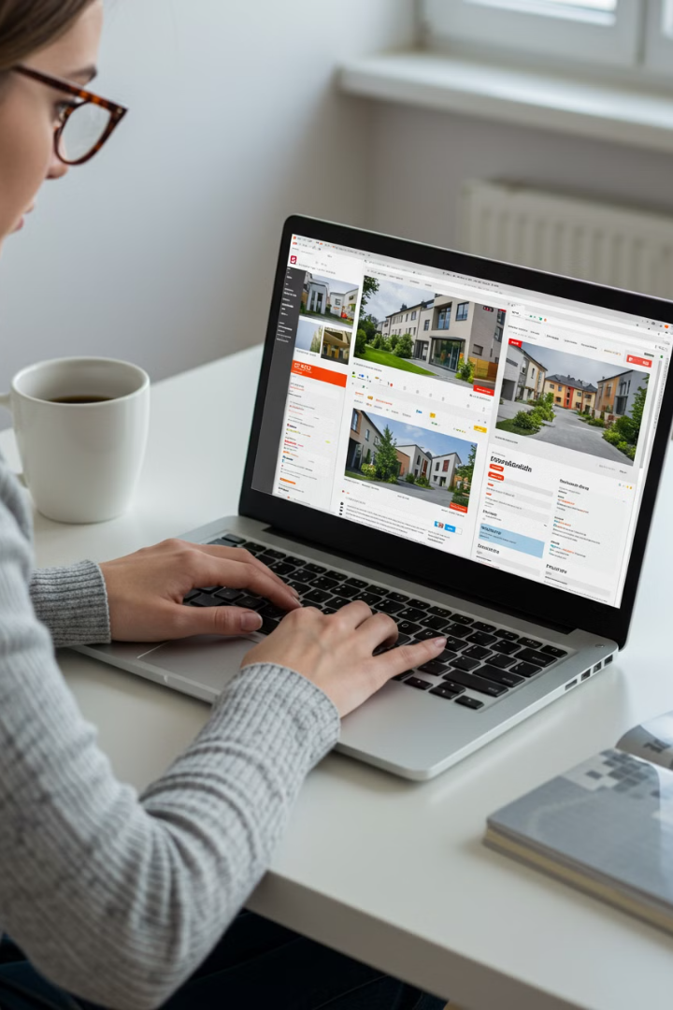
Technology and Rental Search
Virtual Tours
Request video calls to view properties remotely. Particularly useful when searching from abroad before arrival.
Payment Security
Use secure bank transfers for payments. Never send cash or use unsecured money transfer services.
Digital Contracts
Many landlords now offer digital contracts with translation features. Ensure they're legally binding.

Slide 17
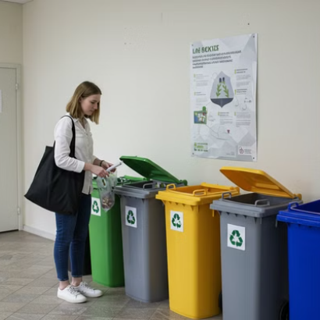
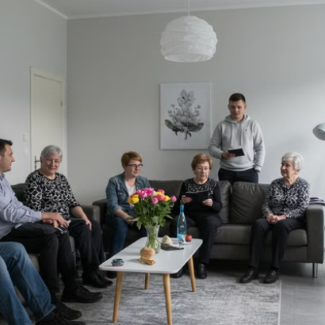
Cultural Adaptation Tips
Understanding Polish rental culture helps build positive relationships. Communication is key, even with language barriers. Learn basic Polish phrases for apartment-related conversations.

Slide 18
Technology and Connectivity
Mobile Plans
Free WiFi Locations
Prepaid options: 20-50 PLN month
University campus
Major providers: Play, Orange, T-Mobile
Public libraries
Most cafés and restaurants
Municipal hotspots in city centers
Reliable internet is essential for studies. Most student accommodations offer high-speed options. Mobile coverage is excellent throughout Poland.

Slide 19
Sustainable Living Strategies
Energy Efficiency
Replace bulbs with LED alternatives
Waste Management
Learn Polish recycling system
Green Transportation
Use bikes and public transit
Polish universities increasingly emphasize sustainability. Many student accommodations now feature energy-efficient appliances and recycling facilities. Sustainability practices often translate to cost savings.

Slide 20
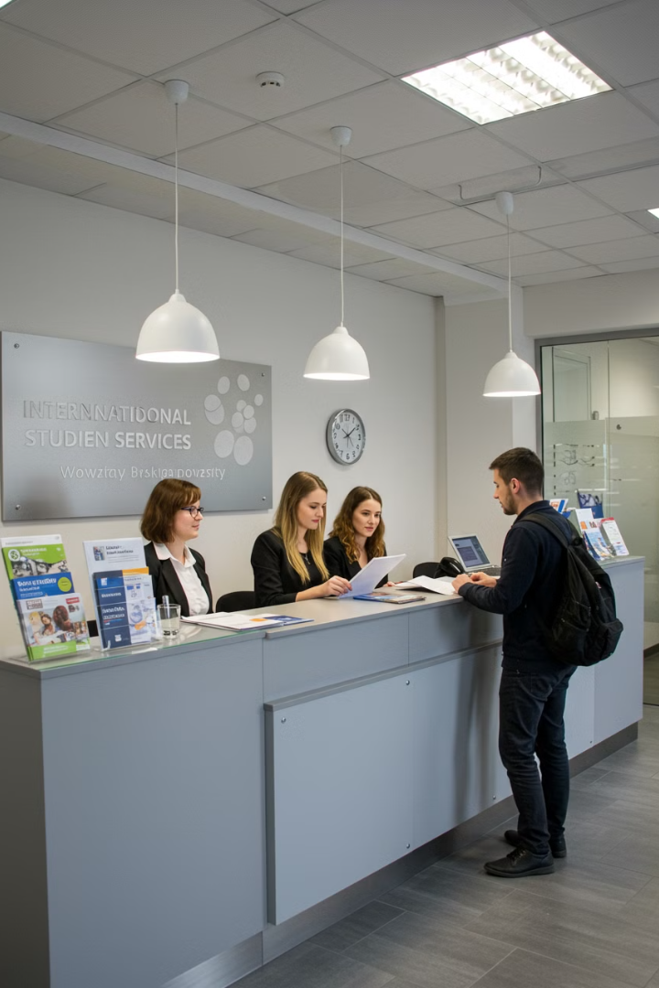
Resources and Support
University Services
Community Support
International student office
Erasmus Student Network
Housing department
Country-specific student associations
Student rights advocate
Financial counseling services
Field of study groups
Alumni mentorship programs
External Resources
City tenant associations
Embassy services
Legal aid offices
Financial literacy workshops
Never hesitate to seek help when needed. Polish universities offer comprehensive support services specifically for international students.

Slide 21
Your Smart Renting Journey
179
40%
Countries Represented
Cost Savings
Join a truly global student community in Poland
Average savings compared to Western European countries
105K+
100%
International Students
Success Rate
And growing every year across Polish universities
With knowledge and preparation, your Polish adventure awaits!
You now have the tools to navigate Poland's rental market confidently. Use this knowledge to create a comfortable, affordable living situation while embracing your international education adventure!

